Slide 1
Contents :
1 What is spring boot
2 Spring boot annotations overview
3 What is Restful web services
4 Spring boot application development steps
5 Application Structure
6 What is angular and Steps to create angular project
7 Angular output pages

Slide 2
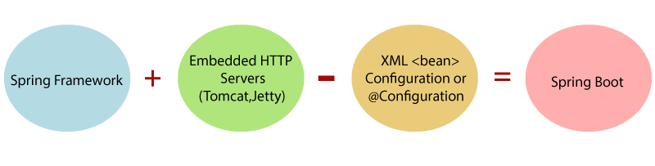
What is Spring Boot
Spring Boot is basically an extension of the Spring framework which eliminated the boilerplate configurations required for setting up a Spring application.
Opinionated ‘starter' dependencies to simplify build and application configuration. Automatic config for Spring functionality – whenever possible
It is a Spring module that provides the RAD (Rapid Application Development) feature to the Spring Framework.

Slide 3
Spring Boot annotations overview
@SpringBootApplication
@EnableAutoConfiguration
@ComponentScan
@Configuration
@Controller and @ Restcontroller
@Component
@CrossOrigin and @PathVariable
@GetMapping , @PostMapping etc. HttpMethods
@Repository
@Transactional and Service
@RequestBody and @ResponseBody and @PathVariable
etc...

Slide 4
What is Restful web services
REST stands for REpresentational State Transfer.
REST is an architectural style not a protocol.
Fast: RESTful Web Services are fast because there is no strict specification like SOAP. It consumes less bandwidth and resource.
Language and Platform independent: RESTful web services can be written in any programming language and executed in any platform.
Can use SOAP: RESTful web services can use SOAP web services as the implementation.
Permits different data format: RESTful web service permits different data format such as Plain Text, HTML, XML and JSON.

Slide 5
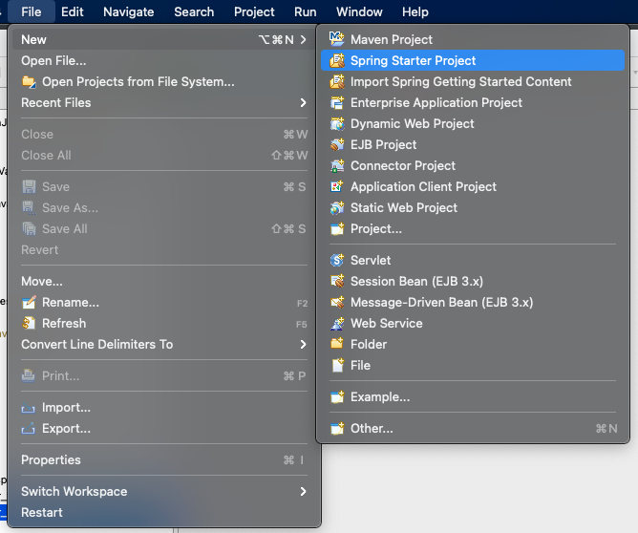
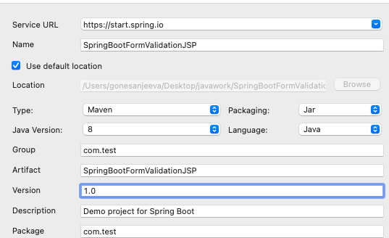
Spring boot application development steps
IDE : STS and Java 8
Student
Student

Slide 6
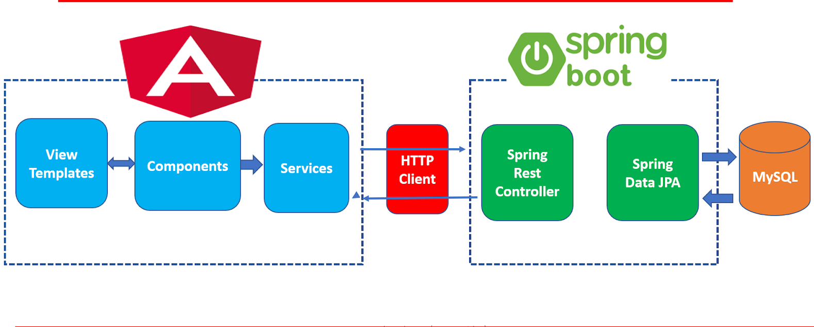
Application structure :

Slide 7
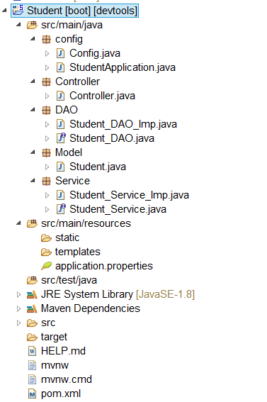
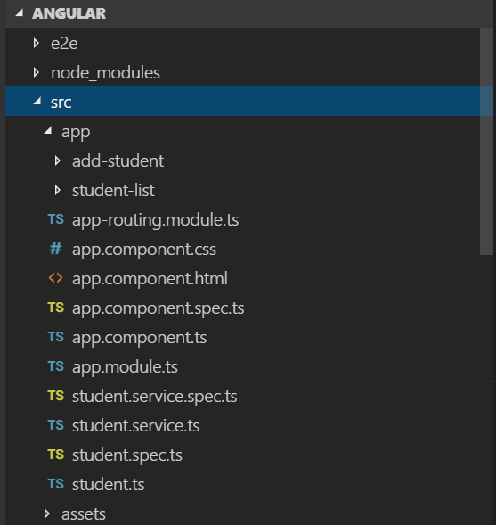
Application Structure Cntd..

Slide 8
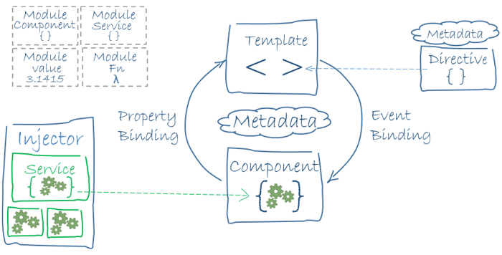
What is angular?
Angular is a platform and framework for building single-page client applications using HTML and TypeScript.
Angular is written in TypeScript. It implements core and optional functionality as a set of TypeScript libraries that you import into your apps.

Slide 9
Steps to create angular project
Create angular project
cmd : ng new Angular
For adding bootstrap CSS :
cmd : npm install bootstrap@3.3.7 --save
Creating data-table
cmd: npm install angular-datatable --save
Creating Components
cmd : ng g c AddStudent and ng g c StudentList
Creating service:
cmd: ng g s Student
Creating the Student.ts class
cmd:ng g class Student

Slide 10
Angular project: (cntd.)
Edit the app.module.ts file:
Import Routing -
Here, we are importing routing file (app-routing.module.ts) and include it in imports array.
Import ReactiveFormsModule -
Here, we are importing ReactiveFormsModule for reactive forms and specify it in imports array.
Import HttpModule -
Here, we are importing HttpModule for server requests and specifying it in imports array.
Register Service class -
Here, we are mentioning the service class in provider's array.

Slide 11
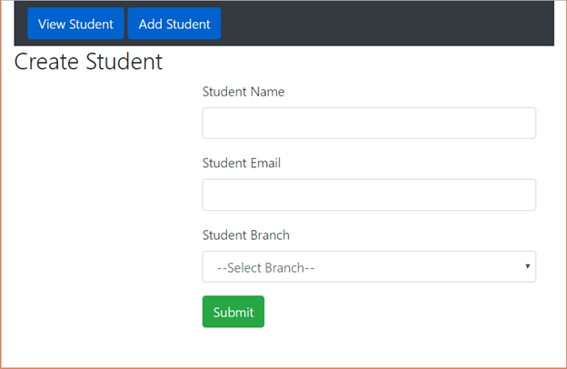
Angular output pages

Slide 12
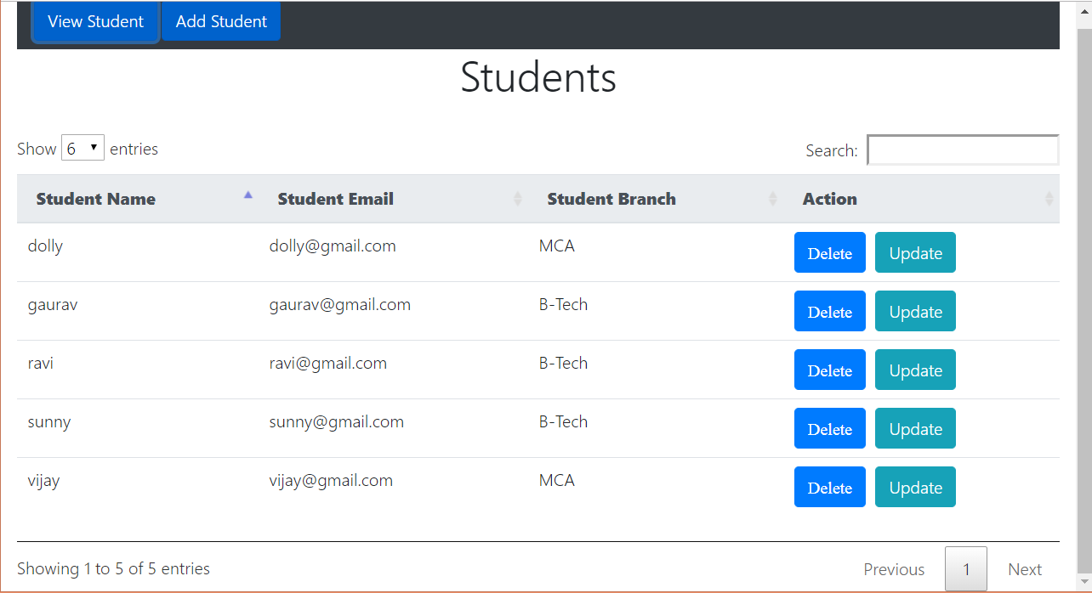
Angular output pages: (cntd..)

Slide 13
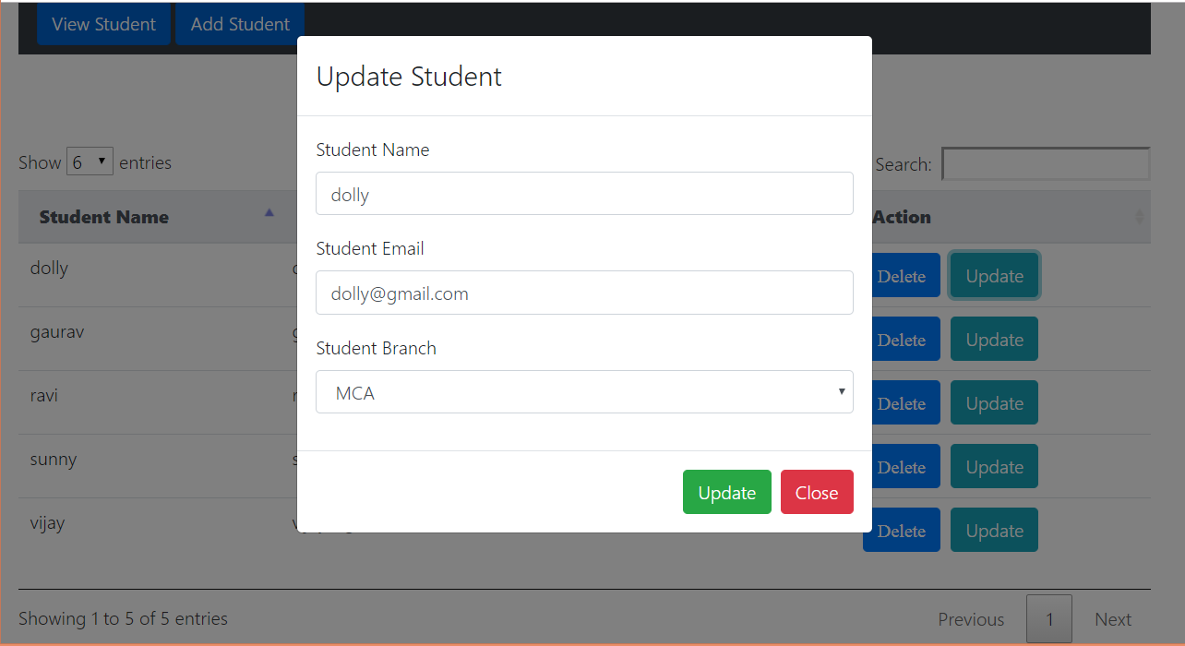
Angular output pages : (cntd..)

Slide 14
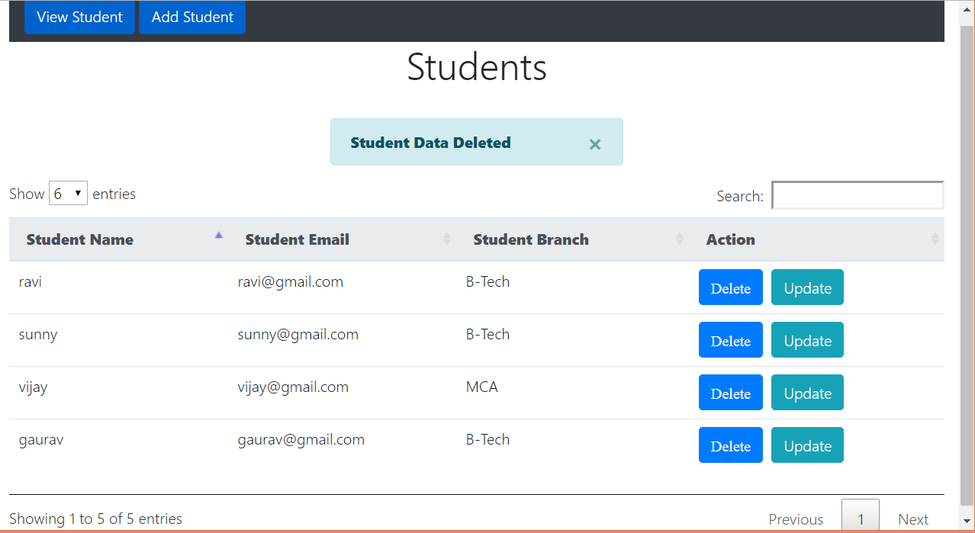
Angular Output pages : (cntd..)

